Slide 1
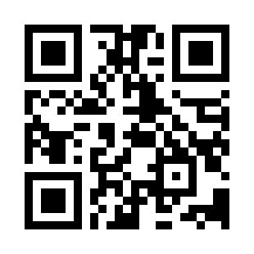


User Interface Design Principles Quiz
https://bit.ly/3SAzcEF

